Slide 1
Binary – Decimal Conversion
Binary numbers are represented as a logical 0 or logical 1 in base 2 format. This means that each number has a place value of 2^{n} where n is the place value position of the binary digit.
The place value start at 2⁰ with the LSB (least significant bit position). For example the binary number 1 0 1 1 has the place values of 2⁰ the LSB position to 2³ for the MSB position.

Slide 2
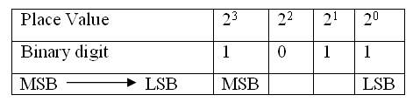
Place Value
1 0 1 1 = 1 x 2³ + 0 x 2² + 1 x 2¹ + 1 x 2⁰
= 11

Slide 3
Example 6-1
Example 6-1
Problem: Given a 32-bit IP address number expressed in binary format, convert the number to a dotted-decimal format.
1 1 0 0 0 0 0 0 1 0 1 0 1 0 0 0 0 0 1 0 0 0 0 0 0 0 0 0 1 1 0 0
octet – 4 octet – 3 octet - 2 octet – 1
Pause the player and resume play when you have an answer.

Slide 4
Example 6-1 Solution
the dotted decimal equivalent is
192.168.32.12

Slide 5
Decimal to binary
The steps for converting decimal numbers to binary
Divide the decimal number by 2, record the remainder of 0 or 1 and write the quotient or result of the division by 2.
Divide the quotient by 2 and record the remainder of 0 or 1. Write the quotient and repeat this step until the quotient is 0.
Write the remainder numbers (0 and 1) in reverse order to obtain the binary equivalent value.

Slide 6
Example 6-2
Convert the decimal number, 12, to binary.

Slide 7
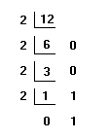
Example 6-2 - Solution
The answer is 1 1 0 0

Slide 8
Example 6-3
Convert 33 to its binary equivalent.

Slide 9
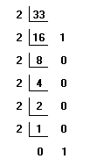
Example 6-3 - Solution
The answer is 1 0 0 0 0 1

Slide 10
Example 6-4
Convert the decimal number 254 to binary.

Slide 11
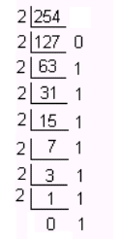
Example 6-4 - Solution

Slide 12
Hexadecimal Numbers
Hexadecimal numbers (HEX) are Base16 numbers. The numbering systems for hexadecimal is provided in Table 5-5 in the text.
It takes four binary numbers to represent a hexadecimal number. Notice that the letters A – F are used to represent the decimal numbers 10 to 15.
The simplest way to convert hexadecimal numbers to binary is through the use of either a calculator or a look up table such as Table 6-5.

Slide 13
Table 6-5 Hexadecimal conversion table
Decimal | Hexadecimal | Binary
0 | 0 | 0 0 0 0
1 | 1 | 0 0 0 1
2 | 2 | 0 0 1 0
3 | 3 | 0 0 1 1
4 | 4 | 0 1 0 0
5 | 5 | 0 1 0 1
6 | 6 | 0 1 1 0
7 | 7 | 0 1 1 1
8 | 8 | 1 0 0 0
9 | 9 | 1 0 0 1
10 | A | 1 0 1 0
11 | B | 1 0 1 1
12 | C | 1 1 0 0
13 | D | 1 1 0 1
14 | E | 1 1 1 0
15 | F | 1 1 1 1

Slide 14
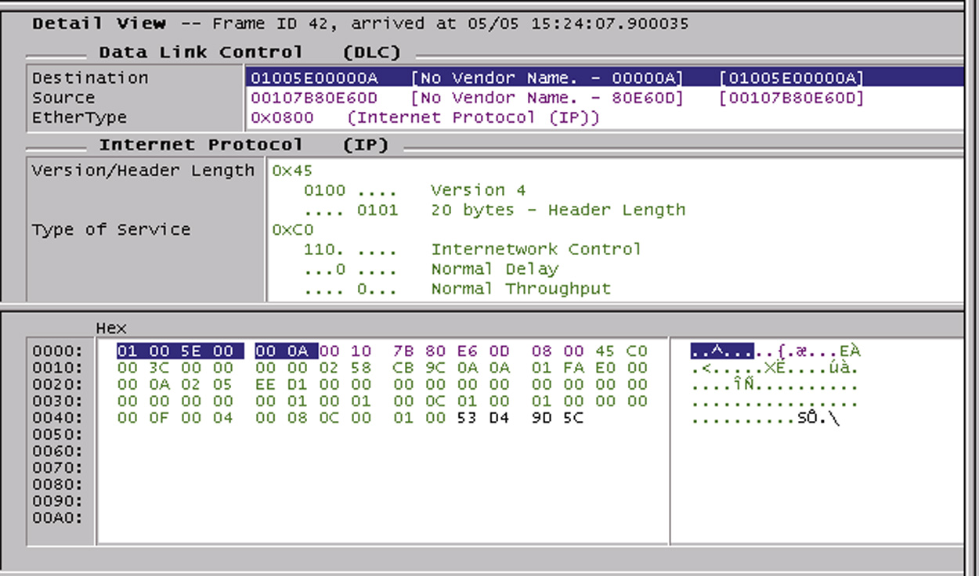
Hexadecimal numbers are used in computer networks to represent the computer’s 12-hex character MAC address and the hex numbers are used to display the packet details in a protocol analyzer as shown.

Slide 15
Hexadecimal numbers are used in computer networks to represent the computer’s 12-hex character MAC address and the hex numbers are used to display the packet details in a protocol analyzer as shown.

Slide 16
Notice the EtherType number is 0x0800 which is defining that this an IP (Internet Protocol) packet. Also note that the numbers at the bottom of the screen are expressed in Hex (hexadecimal) format. These numbers are the values in the data packets.

Slide 17
Notice the EtherType number is 0x0800 which is defining that this an IP (Internet Protocol) packet. Also note that the numbers at the bottom of the screen are expressed in Hex (hexadecimal) format. These numbers are the values in the data packets.

Slide 18
Example 6-5
Convert the following hexadecimal number to binary. 0x48AF

Slide 19
Example 6-5 - Solution
Solution: Use table 6-5 to convert the hex numbers.
Hex: 4 8 A F
Binary: 0 1 0 0 1 0 0 0 1 0 1 0 1 1 1 1

Slide 20
Example 6-6
Convert the following hexadecimal number to binary.
0x0800

Slide 21
Example 6-6 - Solution
Solution: Use table 6-5 to convert the hex numbers.
Hex: 0 8 0 0
Binary: 0 0 0 0 1 0 0 0 0 0 0 0 0 0 0 0

Slide 22
Example 6-7
Convert the following binary number to hexadecimal,
0 1 0 0 1 1 0 0 1 0 1 0

Slide 23
Example 6-7 - Solution
Solution:
Separate the binary numbers into groups of four beginning with the least significant bit position. Next use the lookup table (Table 5-5) to convert each 4-bit binary group to hexadecimal.
0 1 0 1 1 1 0 0 1 0 1 0
4 C A
The answer is 0x4CA.

